Slide 1

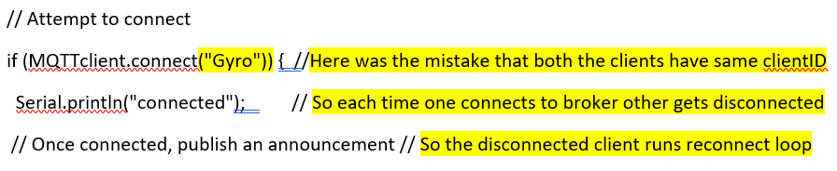

SPRINT 4
Publisher Programming is done similar to WiFi_MQTT sample program with the help of Sepp.
Even it was working, however frequent disconnection was a problem but we solved
Fig: Reconnecting Loop Error
Things realized: Each Clients should have unique client ID to avoid disconnections (Check it in future)

Slide 2
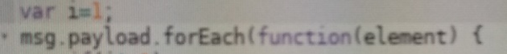
SPRINT 4
Wireshark Anaysis of TLS encryption: it was observed the messages from client Rpi is not encrypted (assisted Sudhan)
Node-red Visualization (for Arduino Robot) is done using “for each() function”_in Javascript
For coherence, modified the order of Lab instructions as per the User stories unlike earlier version. (Better readable order)
Example: “Configuring MQTT Broker” comes under the wireshark analysis of enhanced features (because it is also one of enhanced features of MQTT which needs to analysed by students)
Finally cross-checked Sepp’s documentation & Sudhan’s documentation and gave them feedback for improvement
Fig: For each function_Splits arrays

Slide 3
Thank you for the Opportunity
Tested the Lab Instructions & setup documentation of each others
Also, Improved my setup documentation by feedbacks from sepp
Summary:
Learning a lot of new things in Communication field like wireshark, IP tables firewall etc.
IoT specific softwares like Node-red, Windows IoT core etc.
Getting hands on programming in Linux, Python, C++.
Knowledge about SDKs like Rpi, Arduino.
Some soldering trials and lessons by Prof. etc.
Unfortunately, not involved in LoRawan!
Scrum project Management
Most importantly close caring on Project by Prof. Stahl which lead to finish the Project in expected time.

